Slide 1

CSC/CPE 138 - Computer Network Fundamentals
Application Layer
Introduction
The presentation was adapted from the textbook: Computer Networking: A Top-Down Approach 8th edition Jim Kurose, Keith Ross, Pearson, 2020
The presentation was adapted from the textbook: Computer Networking: A Top-Down Approach 8th edition Jim Kurose, Keith Ross, Pearson, 2020

Slide 2

Application Layer: Overview
P2P applications
video streaming and content distribution networks
socket programming with UDP and TCP
Principles of network applications
Web and HTTP
E-mail, SMTP, IMAP
The Domain Name System DNS

Slide 3








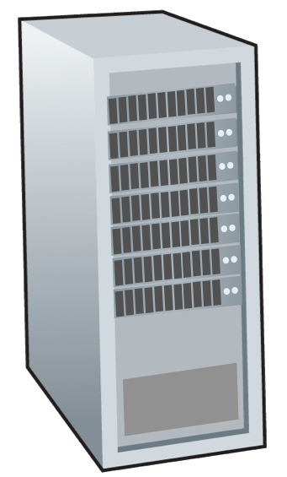







Peer-to-peer (P2P) architecture
no always-on server
arbitrary end systems directly communicate
peers request service from other peers, provide service in return to other peers
self scalability – new peers bring new service capacity, and new service demands
peers are intermittently connected and change IP addresses
complex management
examples: P2P file sharing (BitTorrent), streaming (KanKan), VoIP (Skype)
mobile network
national or global ISP
local or regional ISP
home network
content
provider
network
datacenter
network
enterprise
network

Slide 4

File distribution: client-server vs P2P
Q: how much time to distribute file (size F) from one server to N peers?
peer upload/download capacity is limited resource
u_{s}: server upload capacity
d_{i}: peer i download capacity
file, size F
u₁
d₁
u₂
u_{s}
d₂
server
d_{i}
u_{N}
network (with abundant
bandwidth)
u_{i}
d_{N}
u_{i}: peer i upload capacity

Slide 5
File distribution time: client-server
server transmission: must sequentially send (upload) N file copies:
time to send one copy: F/u_{s}
time to send N copies: NF/u_{s}
F
u_{s}
d_{i}
network
client: each client must download file copy
d_{min} = min client download rate
min client download time: F/d_{min}
u_{i}
time to distribute F
to N clients using
client-server approach
D_{c-s} > max{NF/u_{s,},F/d_{min}}
increases linearly in N

Slide 6
File distribution time: P2P
server transmission: must upload at least one copy:
time to send one copy: F/u_{s}
F
u_{s}
client: each client must download file copy
min client download time: F/d_{min}
d_{i}
network
u_{i}
clients: as aggregate must download NF bits
max upload rate (limiting max download rate) is u_{s} + Σu_{i}
time to distribute F
to N clients using
P2P approach
D_{P2P} > max{F/u_{s,},F/d_{min,},NF/(u_{s} + Σu_{i})}
increases linearly in N …
… but so does this, as each peer brings service capacity

Slide 7
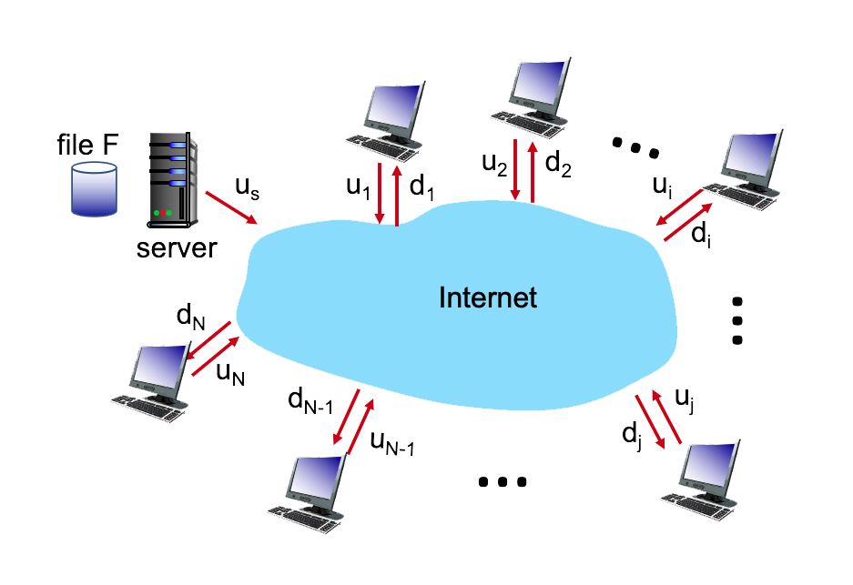
Problem
In this problem, you'll compare the time needed to distribute a file that is initially located at a server to clients via either client-server download or peer-to-peer download. Before beginning, you might want to first review Section 2.5 and the discussion surrounding Figure 2.22 in the text.
The problem is to distribute a file of size F = 10b to each of these 15 peers. Suppose the server has an upload rate of u_{s} = 100bps. The 15 peers have the same upload rates: u_{c} = 10bps The 15 peers have the same download rates: d_{c} =100bps
Compare the minimum time needed to distribute this file between client-server model and peer-to-peer download.

Slide 8
Client-server vs. P2P: example
client upload rate = u, F/u = 1 hour, u_{s} = 10u, d_{min} ≥ u_{s}

Slide 9


P2P file distribution: BitTorrent
file divided into 256Kb chunks
peers in torrent send/receive file chunks
tracker: tracks peers
participating in torrent
torrent: group of peers exchanging chunks of a file
Alice arrives …
… obtains list
of peers from tracker
… and begins exchanging
file chunks with peers in torrent
Notes:
All peers participating in the distribution of a particular file is called a torrent
Peers in a torrent download equal-size chunks of the file from one another, with a typical chunk size of 256 KBytes.
Each torrent has an infrastructure node called a tracker.
Alice, joins the torrent, the tracker
randomly selects a subset of peers (for concreteness, say 50) from the set of participating
peers, and sends the IP addresses of these 50 peers to Alice

Slide 10


P2P file distribution: BitTorrent
peer joining torrent:
has no chunks, but will accumulate them over time from other peers
registers with tracker to get list of peers, connects to subset of peers (“neighbors”)
while downloading, peer uploads chunks to other peers
peer may change peers with whom it exchanges chunks
churn: peers may come and go
once peer has entire file, it may (selfishly) leave or (altruistically) remain in torrent

Slide 11
BitTorrent: requesting, sending file chunks
Requesting chunks:
at any given time, different peers have different subsets of file chunks
periodically, Alice asks each peer for list of chunks that they have
Alice requests missing chunks from peers, rarest first
Sending chunks: tit-for-tat
Alice sends chunks to those four peers currently sending her chunks at highest rate
other peers are choked by Alice (do not receive chunks from her)
re-evaluate top 4 every10 secs
every 30 secs: randomly select another peer, starts sending chunks
“optimistically unchoke” this peer
newly chosen peer may join top 4

Slide 12

BitTorrent: tit-for-tat
(1) Alice “optimistically unchokes” Bob
(2) Alice becomes one of Bob’s top-four providers; Bob reciprocates
(3) Bob becomes one of Alice’s top-four providers
higher upload rate: find better trading partners, get file faster !

